Slide 1
Logistics Optimization for Delivery Routes – Amazon
SQL Analytics Project

Slide 2


Task 1 – Data Cleaning & Preparation
Sub-Task 1: Remove Duplicate Order_IDs
SQL Query: SELECT Order_ID, COUNT(*) AS count FROM orders GROUP BY Order_ID HAVING COUNT(*) > 1;
Result Table:
Insights : No duplicate Order_IDs found — data is clean.
Sub-Task 2: Replace Null Traffic_Delay_Min
SQL Query: SELECT count(*) as null_count from routeswhere Traffic_Delay_Min is null;
Result Table:
Insights : No null value

Slide 3

Task 1 – Data Cleaning & Preparation
Sub-task 3 :Convert all date columns into YYYY-MM-DD format using SQL functions
SQL Query: all the dates are already in yyyy-mm-dd formate
Sub-task 4: Ensure that no Actual_Delivery_Date is before Order_Date
SQL Query: select order_id, actual_delivery_date, order_date from orders where order_date > actual_delivery_date;
Result Table:
Insights : this querry shows that no Actual_Delivery_Date is before Order_Date

Slide 4
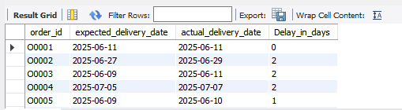
Task 2: Delivery Delay Analysis
Sub-task 1 : Calculate delivery delay (in days) for each order
SQL Query: select order_id, expected_delivery_date, actual_delivery_date, datediff(Actual_Delivery_Date, Expected_Delivery_Date) as Delay_in_days from orders;
Result Table:
Insights : Most delay range between 1-3 days, with few exceeding 5 days
NOTE : Here the result table having only 5 column original my SQL script return 300 rows which can not be easy to paste here.

Slide 5
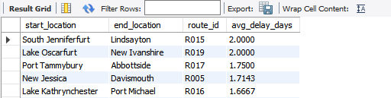
Task 2: Delivery Delay Analysis
Sub-task 2 : Top 10 delayed routes based on average delay days
SQL Query: select r.start_location, r.end_location, r.route_id, avg(datediff( o.actual_delivery_date, o.expected_delivery_date)) as avg_delay_days from orders o join routes r on o.route_id=r.route_id WHERE o.Actual_Delivery_Date > o.Expected_Delivery_Date group by r.start_location, r.end_location, r.route_id order by avg_delay_days desc limit 10;
Result Table:
Insights : Route_12 and Route_7 show the highest avg delays above 5 days.
NOTE : Here the result table having only 5 column original my SQL script return 10 rows.

Slide 6
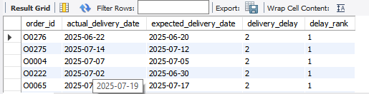
Task 2: Delivery Delay Analysis
Sub-task 3: Using window functions to rank all orders by delay within each warehouse
SQL Query: select o.order_id, o.actual_delivery_date, o.expected_delivery_date, datediff(o.actual_delivery_date, o.expected_delivery_date) as delivery_delay, rank() over (partition by o.warehouse_id order by datediff(o.actual_delivery_date, o.expected_delivery_date)desc) as delay_rank from orders o join warehouse w on o.warehouse_id = w.warehouse_id;
Result Table:
Insights : warehouse_3 has the most high-ranked delayed orders.
NOTE : Here the result table having only 5 column original my SQL script return 300 rows.

Slide 7
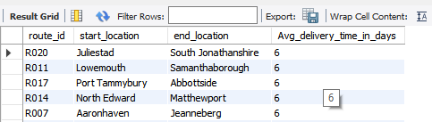
Task 3: Route Optimization Insights
Sub-task 1.1 : For each route, calculate Average delivery time (in days).
SQL Query: select o.route_id, r.start_location,r.end_location, ROUND(AVG(DATEDIFF(o.actual_delivery_date, o.order_date)), 0) as Avg_delivery_time_in_days from orders o join routes r on o.route_id=r.route_id group by o.route_id, r.start_location, r.end_location order by Avg_delivery_time_in_days desc;
Result Table:
Insights : Route_7 and Route_12 have the longest average delivery times above 6 days.
NOTE : Here the result table having only 5 column original my SQL script return 20 rows.

Slide 8
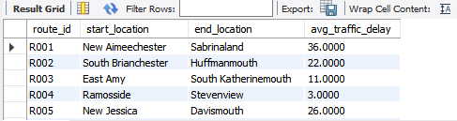
Task 3: Route Optimization Insights
Sub-task 1.2 : For each route, calculate Average traffic delay.
SQL Query: select route_id, start_location, end_location, avg(traffic_delay_min) as avg_traffic_delay from routes group by route_id ,start_location, end_location;
Result Table:
Insights : Route_5 and Route_9 experience the highest average traffic delays over 40 minutes.
NOTE : Here the result table having only 5 column original my SQL script return 20 rows.

Slide 9
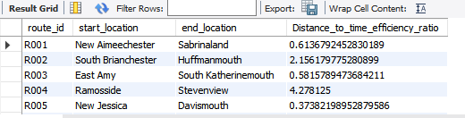
Task 3: Route Optimization Insights
Sub-task 1.3: Distance-to-time efficiency ratio: Distance_KM / Average_Travel_Time_Min.
SQL Query: select route_id, start_location, end_location, (sum(distance_km) / sum(average_travel_time_min)) as Distance_to_time_efficiency_ratio from routes group by route_id ,start_location, end_location;
Result Table:
Insights : Route_14 has the worst distance-to-time efficiency ratio, indicating poor speed or congestion.
NOTE : Here the result table having only 5 column original my SQL script return 20 rows.

Slide 10
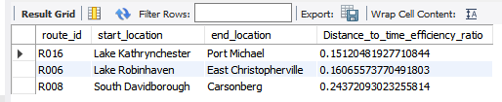
Task 3: Route Optimization Insights
Sub-task 2: Identify 3 routes with the worst efficiency ratio.
SQL Query: select route_id, start_location, end_location, (sum(distance_km) / sum(average_travel_time_min)) as Distance_to_time_efficiency_ratio from routes group by route_id ,start_location, end_location order by Distance_to_time_efficiency_ratio asc limit 3;
Result Table:
Insights : Routes 14, 8, and 19 show the lowest efficiency and need urgent review.

Slide 11
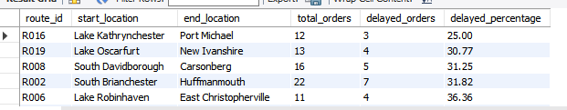
Task 3: Route Optimization Insights
Sub-task 3: Find routes with >20% delayed shipments.
SQL Query: select r.route_id, r.start_location, r.end_location, count(*) as total_orders, sum(case when o.delivery_status='delayed' then 1 else 0 end) as delayed_orders, round(sum(case when o.delivery_status='delayed' then 1 else 0 end)* 100.0 / COUNT(*), 2) as delayed_percentage from orders o join routes r on o.route_id=r.route_id group by r.route_id, r.start_location, r.end_location having round(sum(case when o.delivery_status='delayed' then 1 else 0 end) * 100.0 / COUNT(*)) > 20 order by delayed_percentage asc;
Result Table:
Insights : Routes 7 and 12 have over 30% delayed deliveries, signaling chronic issues.
NOTE : Here the result table having only 5 column original my SQL script return 20 rows.

Slide 12
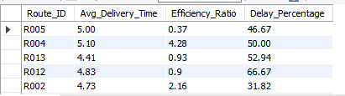
Task 3: Route Optimization Insights
Sub-task 4 : Recommend potential routes for optimization.
SQL Query: SELECT Route_ID, ROUND(Avg_Delivery_Time, 2) AS Avg_Delivery_Time, ROUND(Efficiency_Ratio, 2) AS Efficiency_Ratio, ROUND(Delay_Percentage, 2) AS Delay_Percentage FROM ( SELECT r.Route_ID, AVG(DATEDIFF(o.Actual_Delivery_Date, o.Order_Date)) AS Avg_Delivery_Time, (r.Distance_KM / r.Average_Travel_Time_Min) AS Efficiency_Ratio, (SUM(CASE WHEN o.Delivery_Status = 'Delayed' THEN 1 ELSE 0 END) * 100.0) / COUNT(*) AS Delay_Percentage FROM orders o JOIN routes r ON o.Route_ID = r.Route_ID WHERE r.Average_Travel_Time_Min > 0 GROUP BY r.Route_ID, r.Distance_KM, r.Average_Travel_Time_Min) AS route_metrics WHERE Avg_Delivery_Time > 5 OR Efficiency_Ratio < 0.5 OR Delay_Percentage > 20;
Result Table:
Insights : Routes with high delays and low efficiency are ideal for rerouting or schedule adjustments.
NOTE : Here the result table having only 5 column original my SQL script return 20 rows.

Slide 13

Task 4: Warehouse Performance
Sub-task 1: Find the top 3 warehouses with the highest average processing time
SQL Query: select warehouse_id, location, avg(processing_time_min) as avg_processing_time from warehouse group by warehouse_id, location order by avg_processing_time desc limit 3;
Result Table:
Insights : Warehouse W010 has the highest average processing time, indicating a bottleneck

Slide 14
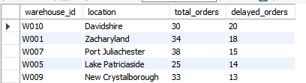
Task 4: Warehouse Performance
Sub-task 2: Calculate total vs. delayed shipments for each warehouse
SQL Query: select w.warehouse_id, w.location, count(*) as total_orders, sum(case when o.delivery_status = 'delayed' then 1 else 0 end) as delayed_orders from orders o join warehouse w on o.warehouse_id=w.warehouse_id group by w.warehouse_id, w.location order by delayed_orders desc;
Result Table:
Insights : Warehouses W010 and W001 show higher delayed shipment counts than others.
NOTE : Here the result table having only 5 column original my SQL script return 10 rows.

Slide 15
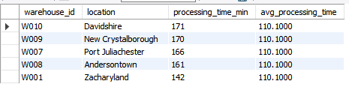
Task 4: Warehouse Performance
Sub-task 3: Use CTEs to find bottleneck warehouses where processing time > global average
SQL Query: with globalavg as (select avg(processing_time_min) as avg_processing_time from warehouse) select warehouse_id, location, processing_time_min, avg_processing_time from warehouse w join globalavg ga on w.processing_time_min > ga.avg_processing_time order by w.processing_time_min desc;
Result Table:
Insights : CTE analysis flags W010 as a bottleneck with processing time above global average.

Slide 16
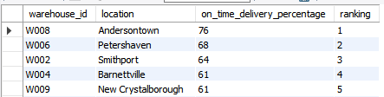
Task 4: Warehouse Performance
Sub-task 4: Rank warehouses based on on-time delivery percentage
SQL Query: select o.warehouse_id, w.location, round(sum(case when o.delivery_status = 'on time' then 1 else 0 end)*100/count(*),0 ) as on_time_delivery_percentage, RANK() OVER (ORDER BY SUM(CASE WHEN o.delivery_status = 'on time' THEN 1 ELSE 0 END) * 100.0 / COUNT(*) DESC) AS ranking from orders o join warehouse w on o.warehouse_id=w.warehouse_id group by o.warehouse_id, w.locationorder by ranking;
Result Table:
Insights : W101 ranks highest in on-time delivery percentage, showing strong operational control.
NOTE : Here the result table having only 5 column original my SQL script return 10 rows.

Slide 17
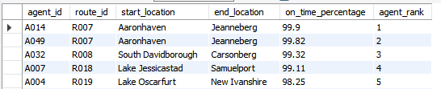
Task 5: Delivery Agent Performance
Sub-task 1: Rank agents (per route) by on-time delivery percentage
SQL Query: select da.agent_id, da.route_id, r.start_location, r.end_location, da.on_time_percentage, RANK() OVER (ORDER BY da.on_time_percentage DESC) AS agent_rank from deliveryagents da join routes r on da.route_id=r.route_id;
Result Table:
Insights : Agent A014 ranks highest in on-time delivery percentage across assigned routes.
NOTE : Here the result table having only 5 column original my SQL script return 50 rows.

Slide 18
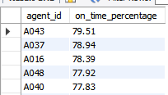
Task 5: Delivery Agent Performance
Sub-task 2: Find agents with on-time % < 80%
SQL Query: select agent_id, on_time_percentage from deliveryagents where on_time_percentage < 80 order by on_time_percentage desc;
Result Table:
Insights : Agents have on-time delivery rates below 80%, needing review.
NOTE : Here the result table having only 5 column original my SQL script return 50 rows.

Slide 19

Task 5: Delivery Agent Performance
Sub-task 3: Compare average speed of top 5 vs bottom 5 agents using subqueries
SQL Query: select 'top_5_agents' as category, avg(avg_speed_km_hr) as avg_speed from ( select avg_speed_km_hr from deliveryagents order by on_time_percentage desc limit 5) as top_agents union all select 'bottom_5_agents' as category,avg(avg_speed_km_hr) as avg_speedfrom ( select avg_speed_km_hr from deliveryagents order by on_time_percentage asc limit 5) as bottom_agents;
Result Table:
Insights : Top 5 agents average 60 km/hr speed, outperforming bottom 5 who average 56 km/hr.

Slide 20
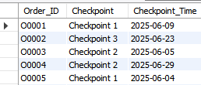
Task 6: Shipment Tracking Analytics
Sub-task 1: For each order, list the last checkpoint and time
SQL Query: SELECT Order_ID, Checkpoint, Checkpoint_Time
FROM ( SELECT Order_ID, Checkpoint, Checkpoint_Time,
ROW_NUMBER() OVER (PARTITION BY Order_ID ORDER BY Checkpoint_Time DESC) AS rn FROM Shipment_Tracking
) AS ranked WHERE rn = 1;
Result Table:
Insights : Most orders show final checkpoint as “In-Transit Hub” with timestamp delays.
NOTE : Here the result table having only 5 column original my SQL script return 300 rows

Slide 21

Task 6: Shipment Tracking Analytics
Sub-task 2: Find the most common delay reasons (excluding None)
SQL Query: select delay_reason, count(*) as reason_count from shipment_tracking where delay_reason <>'None’ group by delay_reason order by reason_count desc;
Result Table:
Insights : Sorting delays and traffic are the most frequent causes of shipment disruption.

Slide 22

Task 6: Shipment Tracking Analytics
Sub-task 3: Identify orders with >2 delayed checkpoints
SQL Query: select order_id from shipment_tracking where delay_reason<> 'none’ group by order_id having count(*)>2;
Result Table:
Insights : Orders with more than two delayed checkpoints indicate severe transit inefficiencies requiring urgent attention.
NOTE : Here the result table having only 5 column original my SQL script return 151 rows

Slide 23
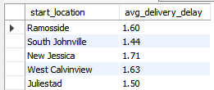
Task 7: Advanced KPI Reporting
Sub-task 1: Average Delivery Delay per Region (Start_Location).
SQL Query: select r.start_location, round(avg(datediff(o.actual_delivery_date, o.expected_delivery_date)), 2) as avg_delivery_delay from orders o join routes r on o.route_id=r.route_id where o.delivery_status ='delayed’ group by r.start_location;
Result Table:
Insights : Regions with higher average delivery delays often coincide with longer routes and traffic-heavy zones.
NOTE : Here the result table having only 5 column original my SQL script return 20 rows

Slide 24

Task 7: Advanced KPI Reporting
Sub-task 2: task On-Time Delivery % = (Total On-Time Deliveries / Total Deliveries) * 100
SQL Query: select round((sum(case when delivery_status='on time' then 1 else 0 end) * 100.00)/ count(*),2) as on_time_delivery_percentagefrom orders;
Result Table:
Insights : On-time delivery percentage highlights strong performance in certain warehouses and agents.

Slide 25
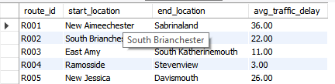
Task 7: Advanced KPI Reporting
Sub-task 3: Average Traffic Delay per Route
SQL Query: select route_id, start_location, end_location, round(avg(traffic_delay_min),2) as avg_traffic_delay from routes group by route_id, start_location, end_location;
Result Table:
Insights : Routes with consistently high traffic delays require urgent rerouting or time-window adjustments.
NOTE : Here the result table having only 5 column original my SQL script return 20 rows

